Slide 1
Parallel and Distributed Computation OpenMP
Kun Suo
Computer Science, Kennesaw State University
https://kevinsuo.github.io/

Slide 2

Scope of Variables

Slide 3
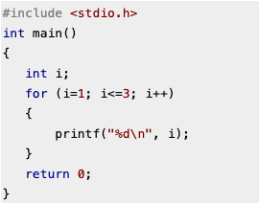
Scope
In serial programming, the scope of a variable consists of those parts of a program in which the variable can be used.

Slide 4
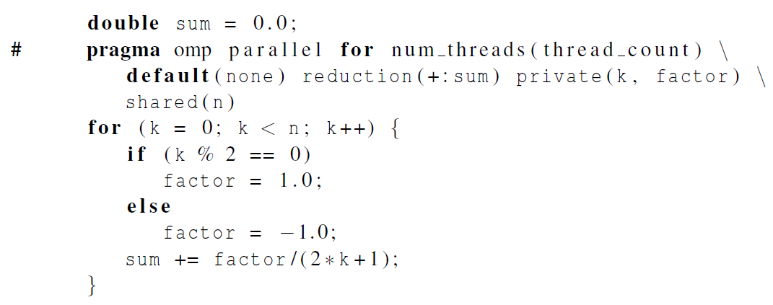
Scope
In OpenMP, the scope of a variable refers to the set of threads that can access the variable in a parallel block.
Computer Science
Parallel and Distributed Computation

Slide 5
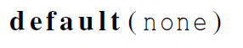
The default clause
Let the programmer specify the scope of each variable in a block.
With this clause the compiler will require that we specify the scope of each variable we use in the block and that has been declared outside the block.

Slide 6
The default clause

Slide 7

Scope in OpenMP
A variable that can be accessed by all the threads in the team has shared scope.
A variable that can only be accessed by a single thread has private scope.
The default scope for variables declared before a parallel block is shared.

Slide 8
The default clause
Vairable k and factor are private;
Variable n is shared.

Slide 9

The Reduction Clause

Slide 10
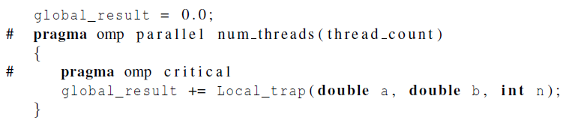
Our example
If we write the code like this…
… we force the threads to execute sequentially.

Slide 11
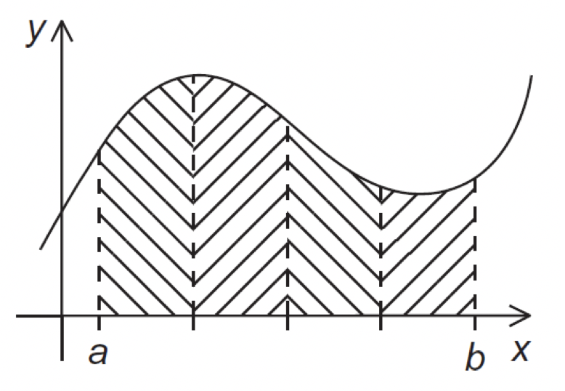

Rank = 1
Rank = 2
(a) To (a)
no communication
Rank = n
(a) To (b)
communication
Rank = 0

Slide 12
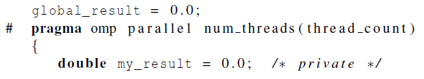
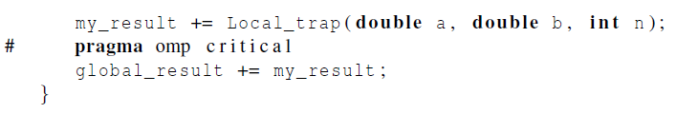
Our example
We can avoid this problem by declaring a private variable inside the parallel block and moving the critical section after the function call.
Private: Parallel computation
Public: Serial computation

Slide 13
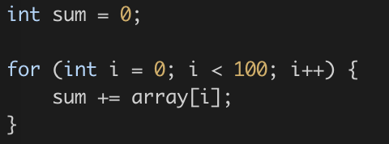
The Reduction Clause
A common loop is to accumulate variables
sum needs to be private for parallelization
sum needs to be public for the correct answer

Slide 14
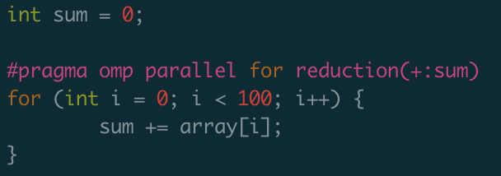
The Reduction Clause
In the internal implementation, OpenMP provides a private sum variable for each thread.
When the thread exits, OpenMP adds the sum of each thread's parts to get the final result.

Slide 15
The Reduction Clause
=

Slide 16
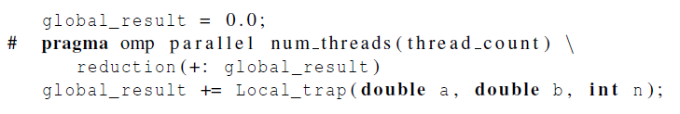
Reduction operators
+, *, -, &, |, ˆ, &&, ||
The global_result is private for each thread and public for the master thread

Slide 17

The “Parallel For” Directive

Slide 18
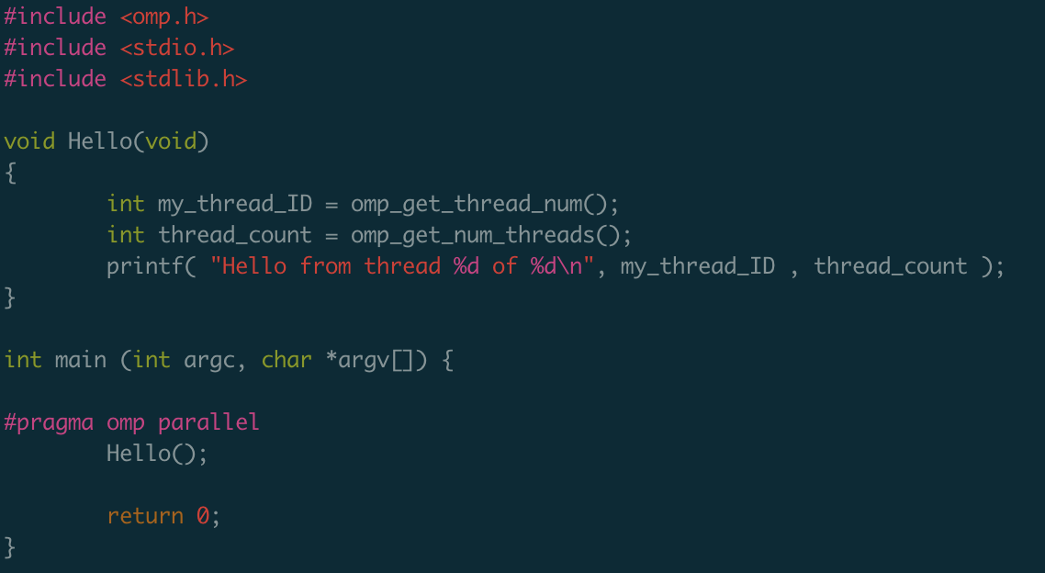
Pragmas
https://github.com/kevinsuo/CS7172/blob/master/omp-helloworld.c
omp.h file
Return 0,1,2,3
Thread number is decided by core number

Slide 19
Parallel for
Forks a team of threads to execute the following structured block.
However, the structured block following the parallel for directive must be a for loop.

Slide 20

Parallel for
Furthermore, with the parallel for directive the system parallelizes the for loop by dividing the iterations of the loop among the threads.

Slide 21
Parallel for Example

Slide 22
Data dependencies: fibonacci series
fibo[ 0 ] = fibo[ 1 ] = 1;
for (i = 2; i < n; i++)
fibo[ i ] = fibo[ i – 1 ] + fibo[ i – 2 ];

Slide 23
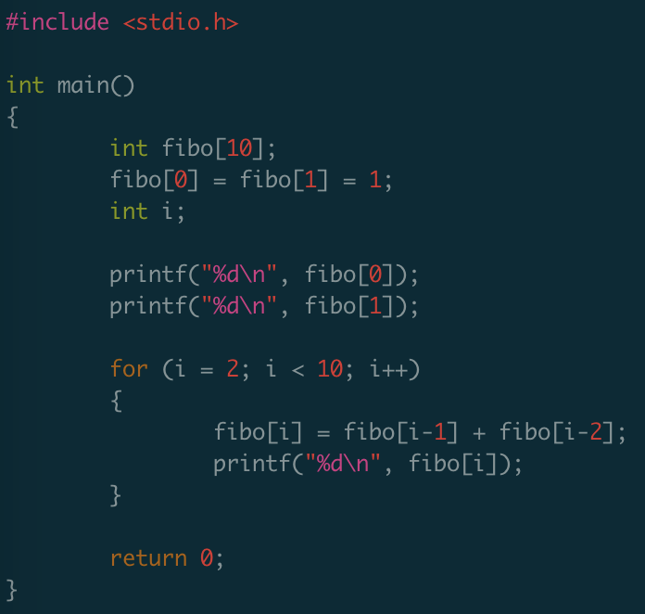
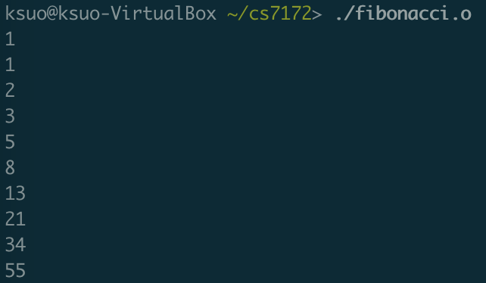
Data dependencies
https://github.com/kevinsuo/CS7172/blob/master/fibonacci.c
Fibonacci in serial

Slide 24
Data dependencies
fibo[ 0 ] = fibo[ 1 ] = 1;
for (i = 2; i < n; i++)
fibo[ i ] = fibo[ i – 1 ] + fibo[ i – 2 ];
note 2 threads
fibo[ 0 ] = fibo[ 1 ] = 1;
# pragma omp parallel for num_threads(2)
for (i = 2; i < n; i++)
fibo[ i ] = fibo[ i – 1 ] + fibo[ i – 2 ];

Slide 25
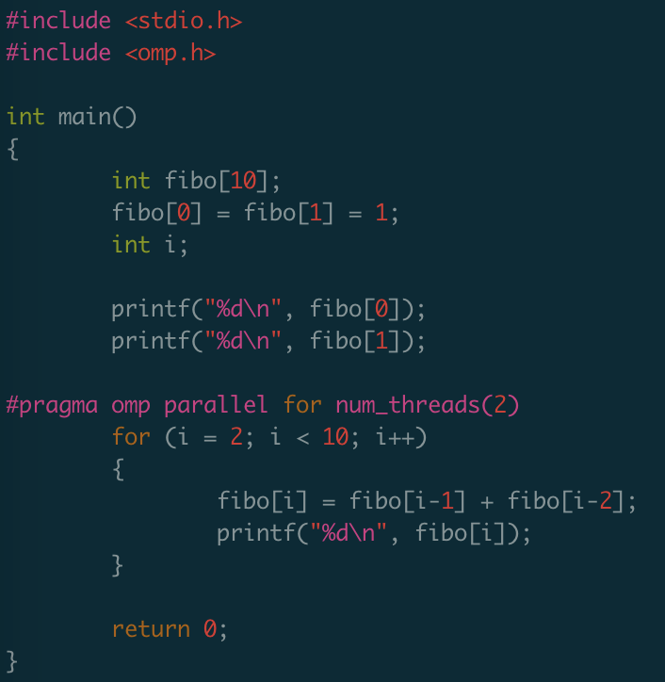
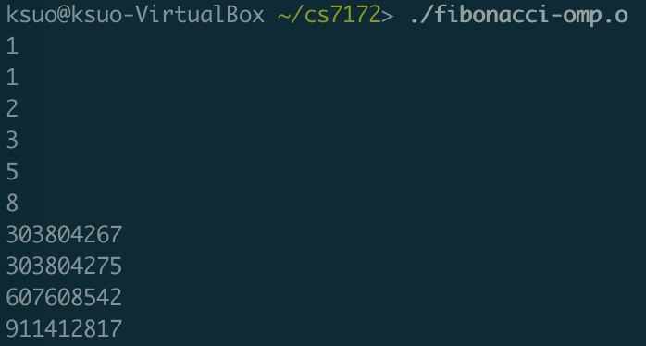
Data dependencies
https://github.com/kevinsuo/CS7172/blob/master/fibonacci-omp.c
Fibonacci in openmp
$ gcc -fopenmp xxx.c -o xxx.o

Slide 26

What happened?
OpenMP compilers don’t check for dependences among iterations in a loop that’s being parallelized with a parallel for directive.
A loop in which the results of one or more iterations depend on other iterations cannot be correctly parallelized by OpenMP.

Slide 27
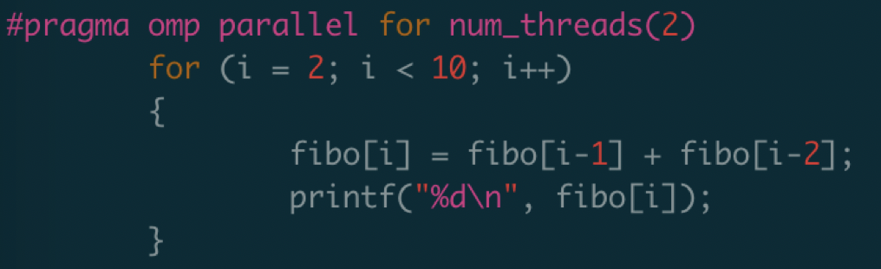
What happened?
Thread 1
Thread 2
fibo[2], fibo[3], fibo[4], fibo[5]
fibo[6], fibo[7], fibo[8], fibo[9]
data dependency
What will happen if thread 2 runs ahead of thread 1?

Slide 28
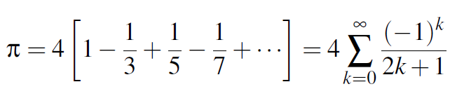
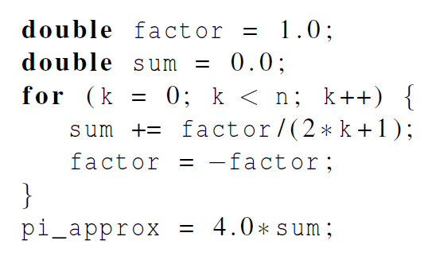
Example: Estimating π

Slide 29
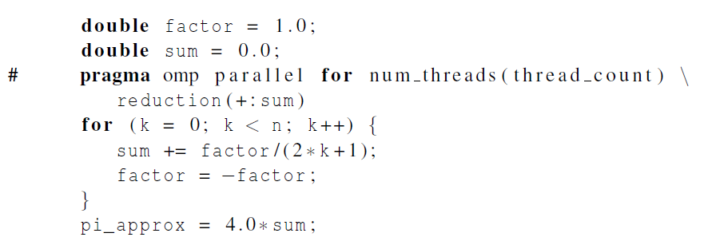
OpenMP solution #1
https://github.com/kevinsuo/CS7172/blob/master/pi-cal.c
loop dependency: the factor in k^{th} iteration has dependency of the k-1th iteration

Slide 30
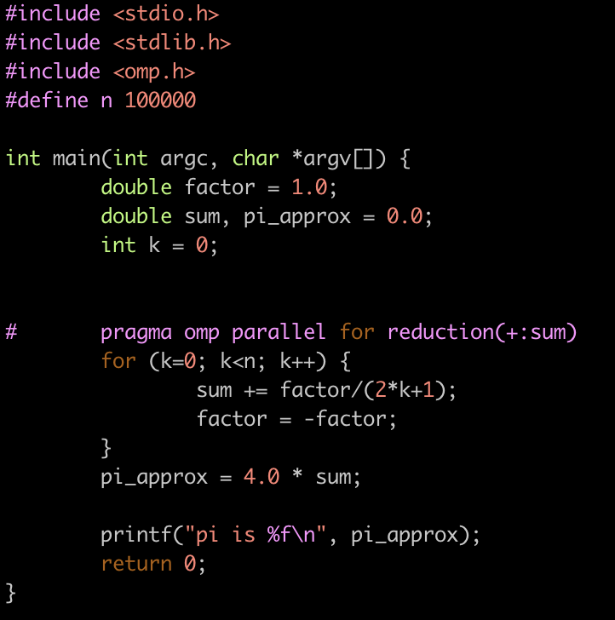
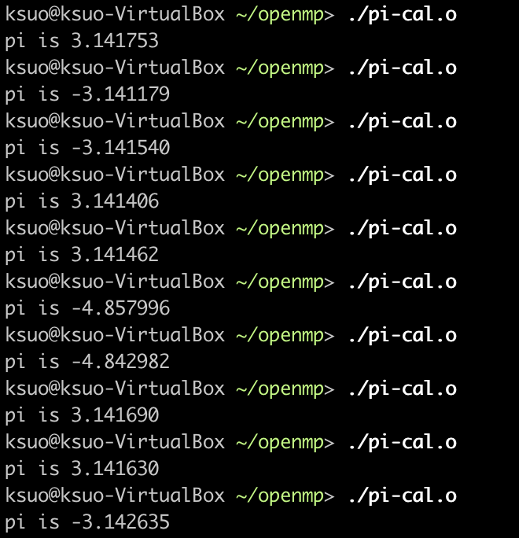
OpenMP solution #1
https://github.com/kevinsuo/CS7172/blob/master/pi-cal.c
gcc pi-cal.c -o pi-cal.o -fopenmp

Slide 31
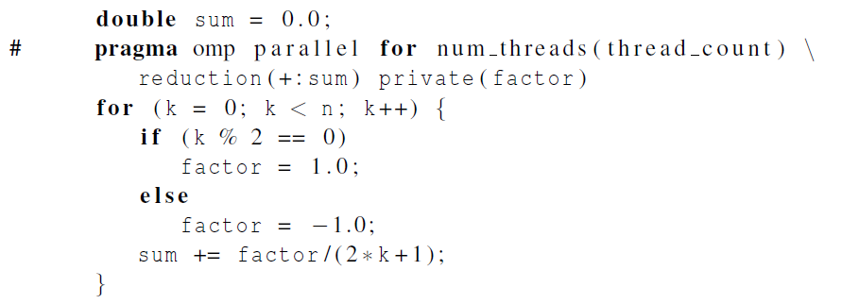
OpenMP solution #2
Insures factor has private scope.

Slide 32
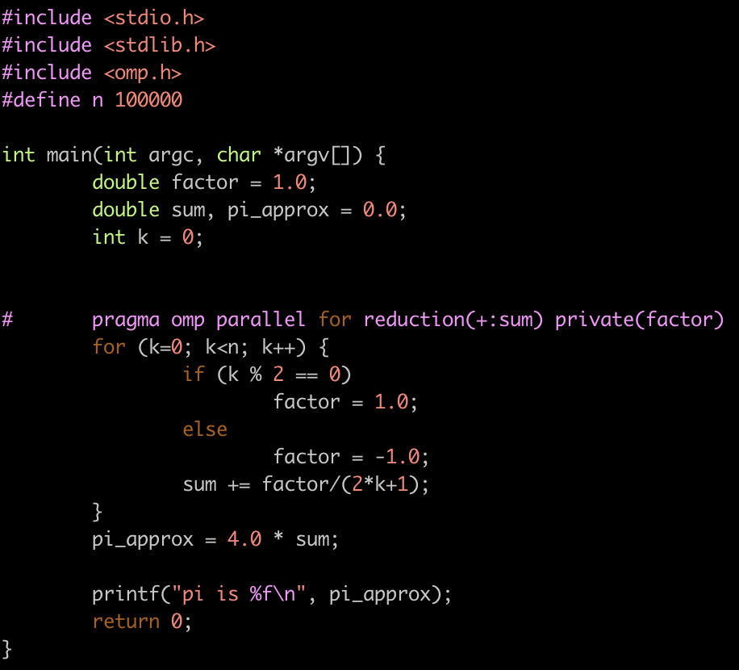
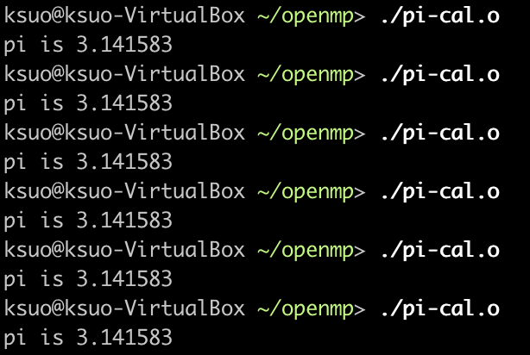
OpenMP solution #2
https://github.com/kevinsuo/CS7172/blob/master/pi-cal-2.c

Slide 33
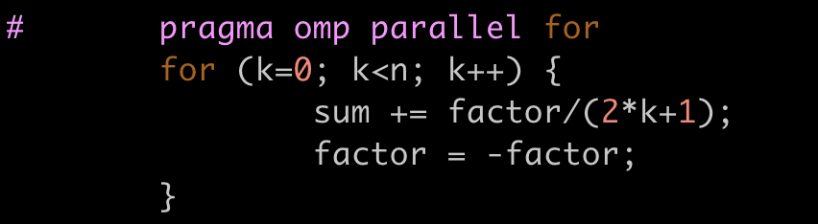
Which thread executes which round of loop?
Thread 1
Thread 2
k=0
=1
=2
=3
… …
=10
=11
=n
Thread 3
Thread 4

Slide 34
schedule ( type , chunksize )
Type can be:
static: the iterations can be assigned to the threads before the loop is executed.
dynamic or guided: the iterations are assigned to the threads while the loop is executing.
auto: the compiler and/or the run-time system determine the schedule.
runtime: the schedule is determined at run-time.
The chunksize is a positive integer.

Slide 35
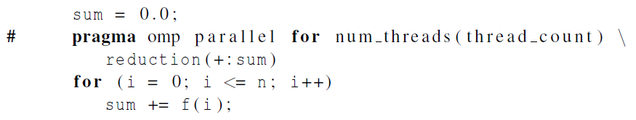
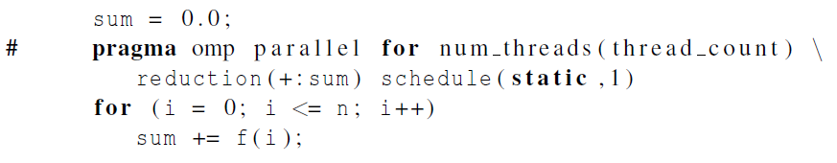
The Schedule Clause
Default schedule:
Cyclic schedule:

Slide 36
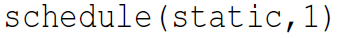
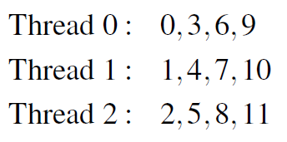
The Static Schedule Type
twelve iterations, 0, 1, . . . , 11, and three threads

Slide 37
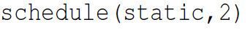
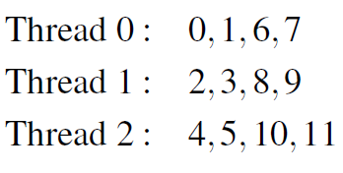
The Static Schedule Type
twelve iterations, 0, 1, . . . , 11, and three threads

Slide 38
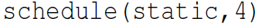
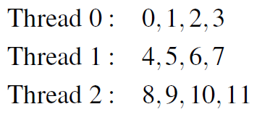
The Static Schedule Type
twelve iterations, 0, 1, . . . , 11, and three threads

Slide 39
The Dynamic Schedule Type
The iterations are also broken up into chunks of chunksize consecutive iterations.
Each thread executes a chunk, and when a thread finishes a chunk, it requests another one from the run-time system.
This continues until all the iterations are completed.
The allocation results are unpredictable.

Slide 40

The Dynamic Schedule Type
twelve iterations, 0, 1, . . . , 11, and three threads

Slide 41
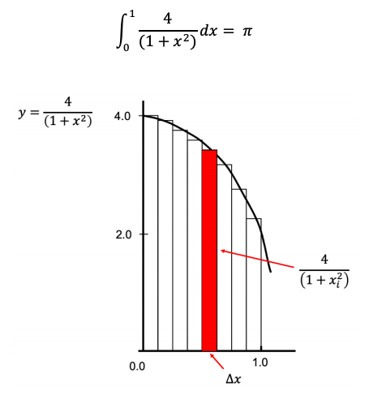

Approximate the value of $π$

Slide 42
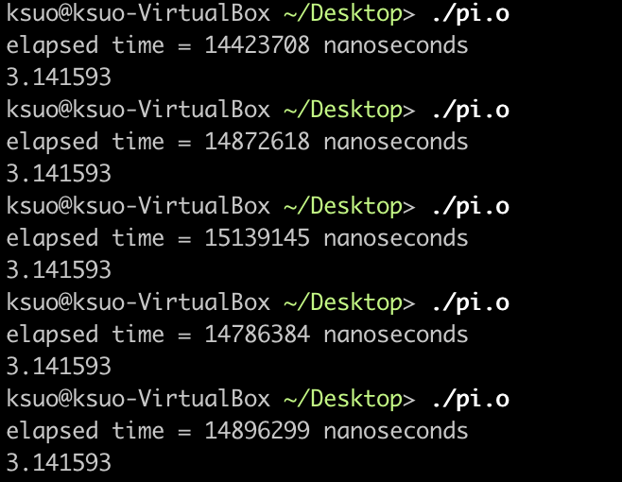
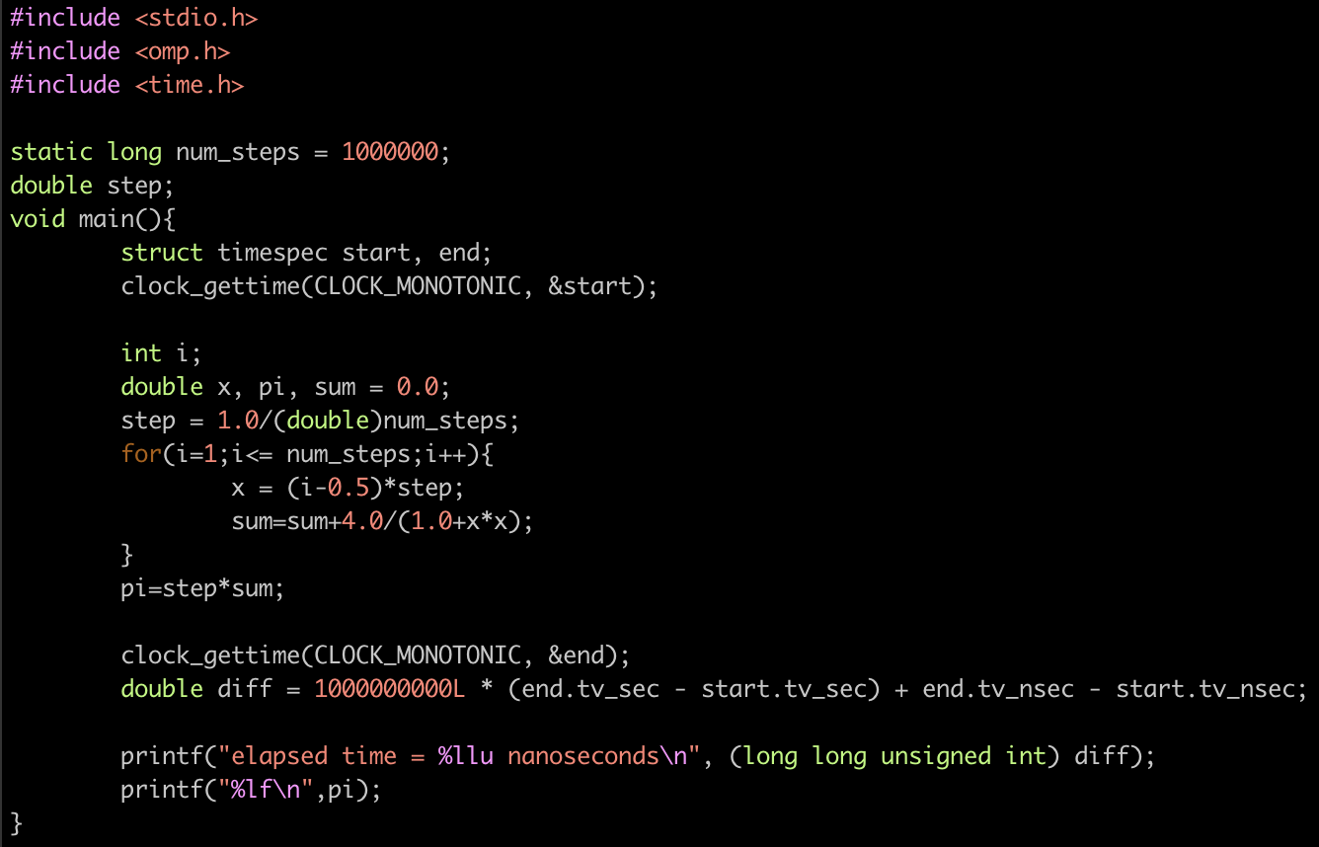
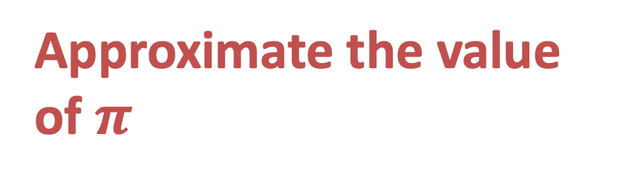
Approximate the value of $π$
https://github.com/kevinsuo/CS7172/blob/master/pi-non-openmp.c

Slide 43
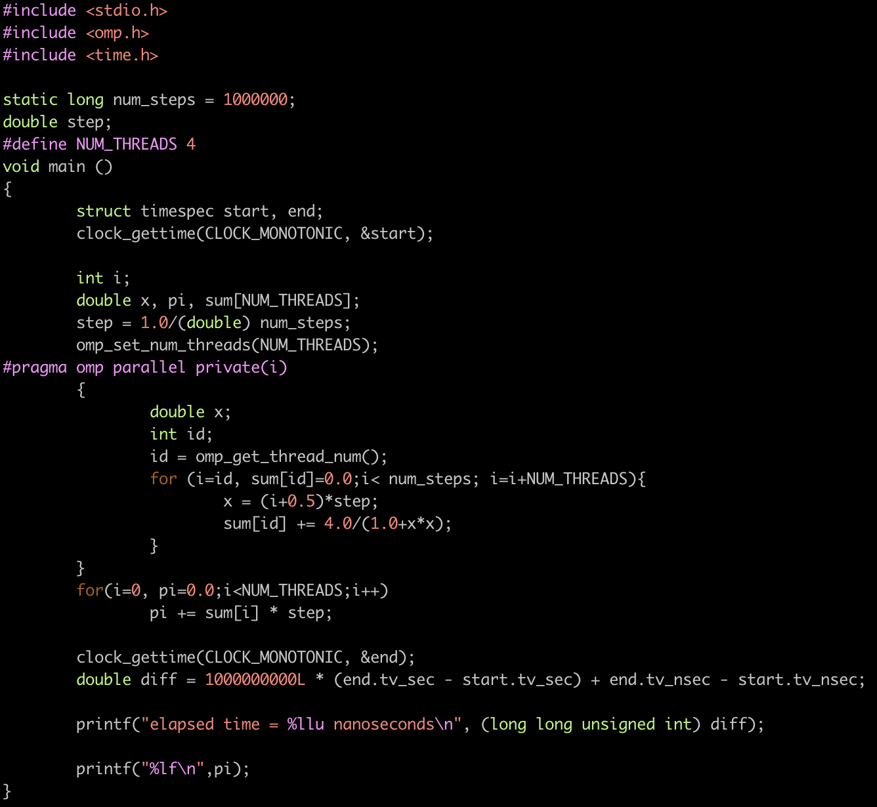
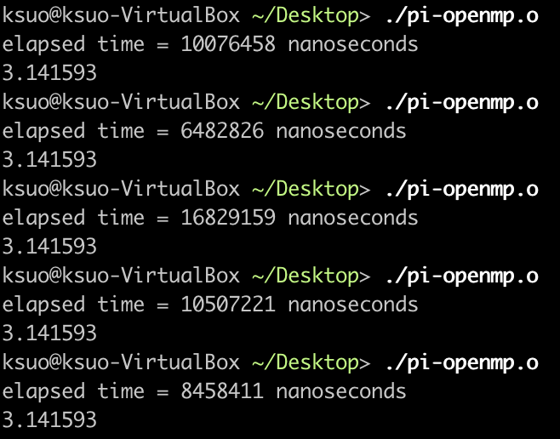
Approximate the value of $π$
https://github.com/kevinsuo/CS7172/blob/master/pi-openmp.c

Slide 44
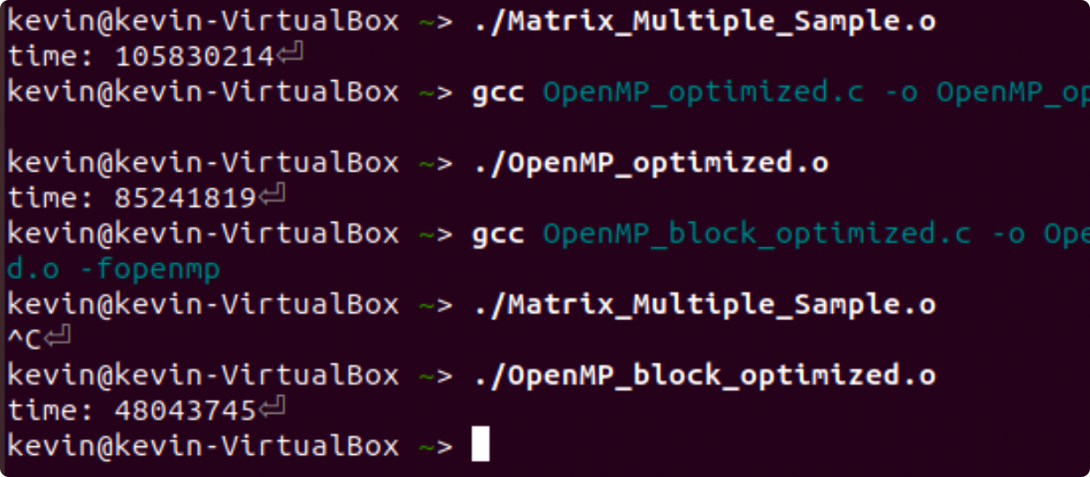
Matrix multiplication
Expected output
Using OpenMP + block
Using OpenMP
Single thread

Slide 45
An example of parallel and distributed computation: Matrix multiplication

Slide 46
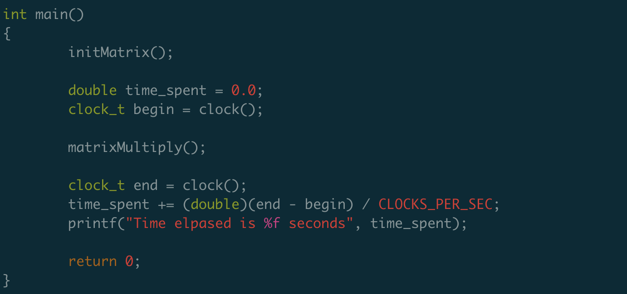
Matrix multiply
https://github.com/kevinsuo/CS7172/blob/master/matrix.c

Slide 47
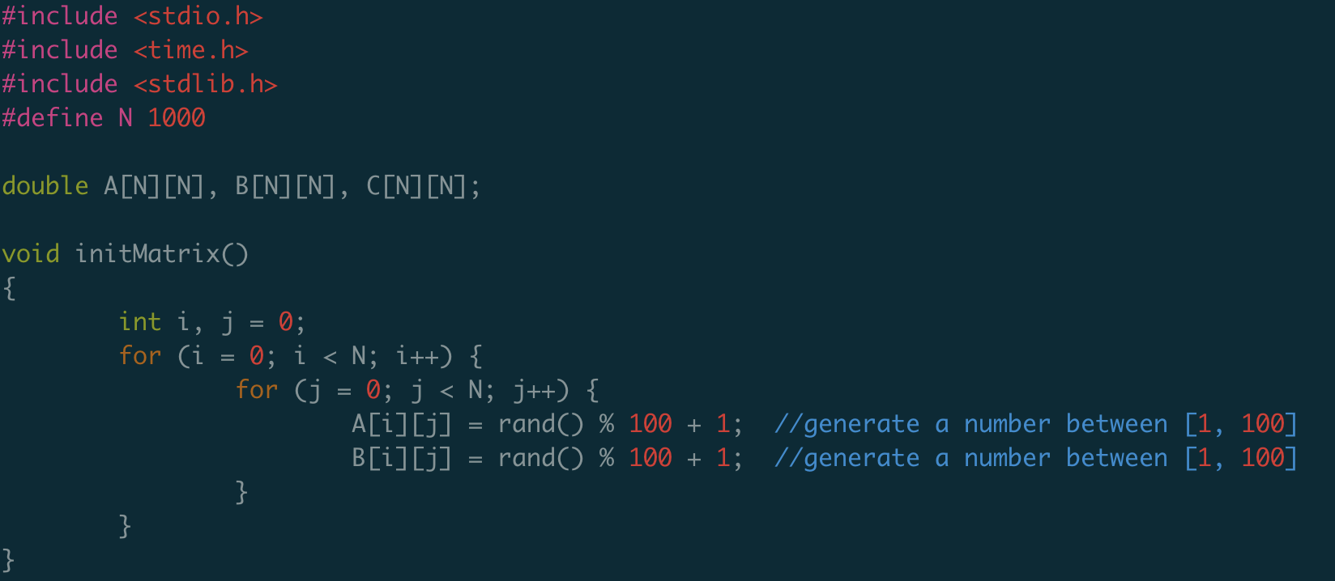
Matrix multiply
https://github.com/kevinsuo/CS7172/blob/master/matrix.c

Slide 48
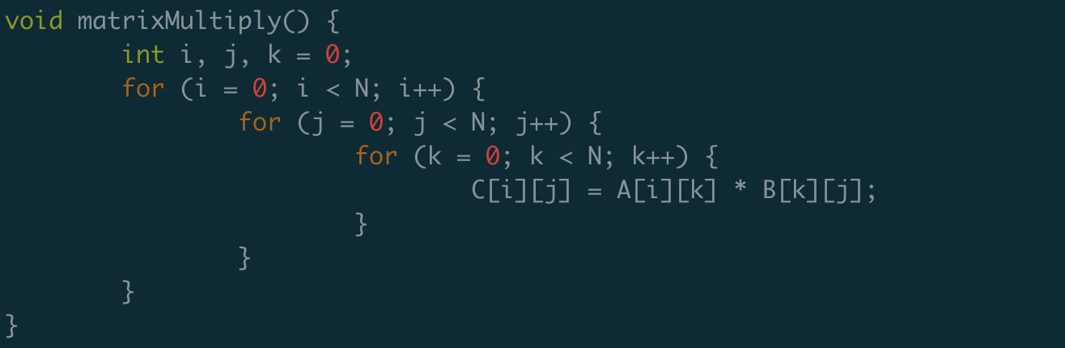
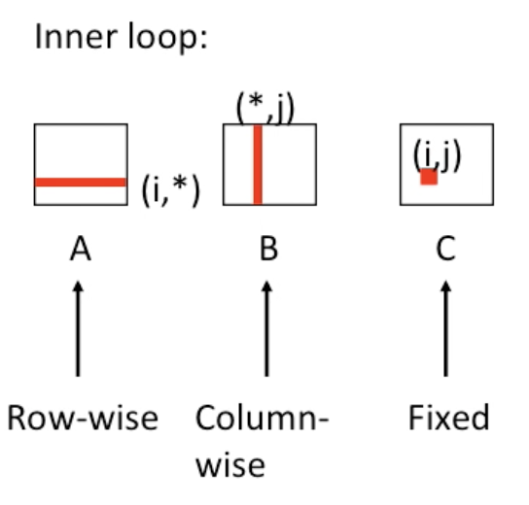
Matrix multiply
https://github.com/kevinsuo/CS7172/blob/master/matrix.c

Slide 49
Matrix multiply
https://github.com/kevinsuo/CS7172/blob/master/matrix.c
How to run it faster?
Accelerate serial execution
Accelerate in parallel

Slide 50
How to run it faster?
Accelerate serial execution
Reduce unnecessary steps
2. Accelerate in parallel

Slide 51
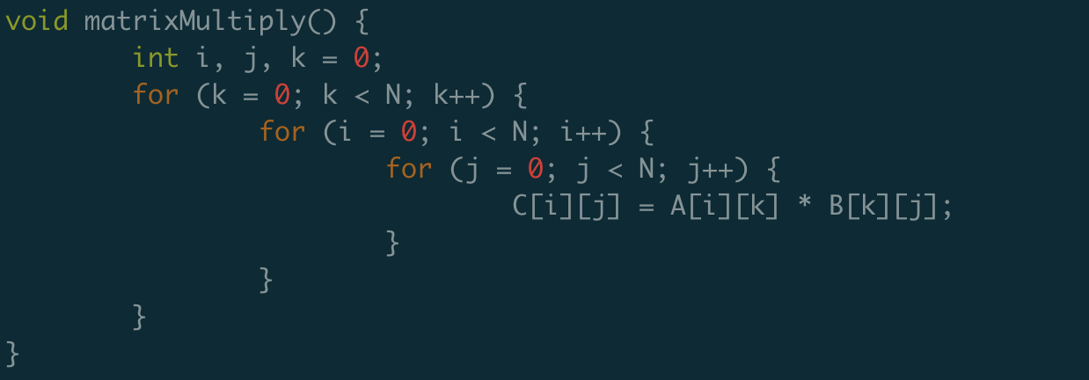
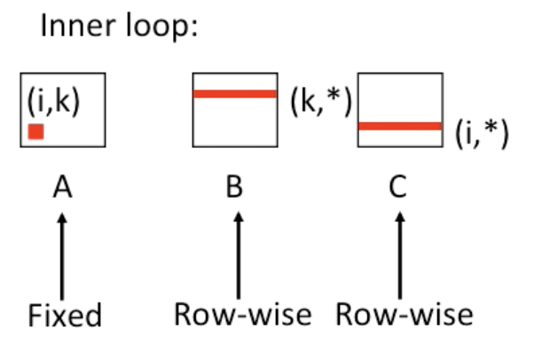
Option 1: Optimization using locality
https://github.com/kevinsuo/CS7172/blob/master/matrix-opt.c

Slide 52
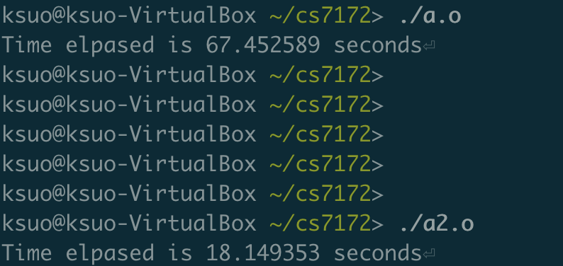
Option 1: Optimization using locality
N=2000
3.7x

Slide 53
Option 1: Optimization using locality
Temporal locality
Every inner loop reuse the value of A[i, k]
Spatial locality
Divide the large matrix into smaller ones and put it inside the cache during calculation

Slide 54
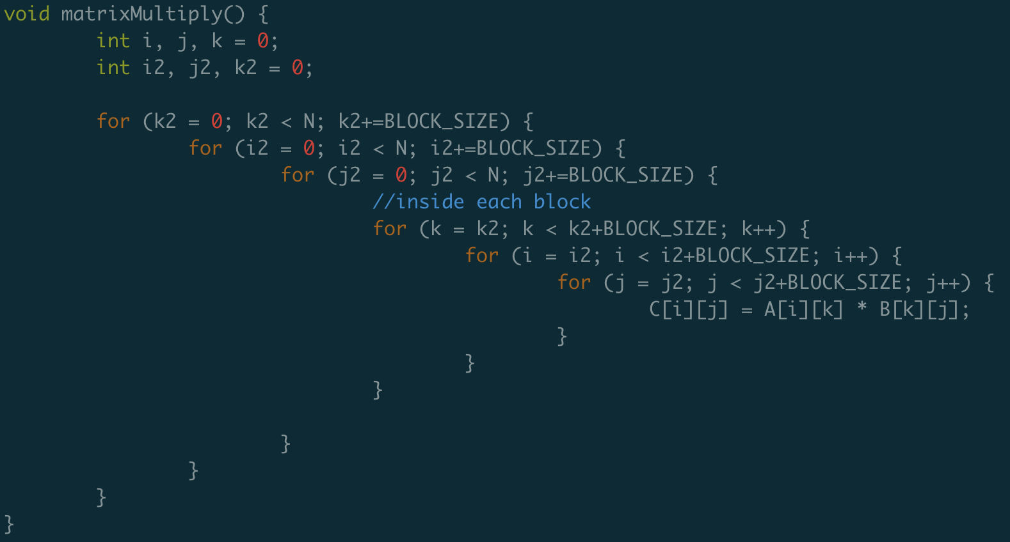
Option 1: Optimization using locality
https://github.com/kevinsuo/CS7172/blob/master/matrix-opt2.c

Slide 55
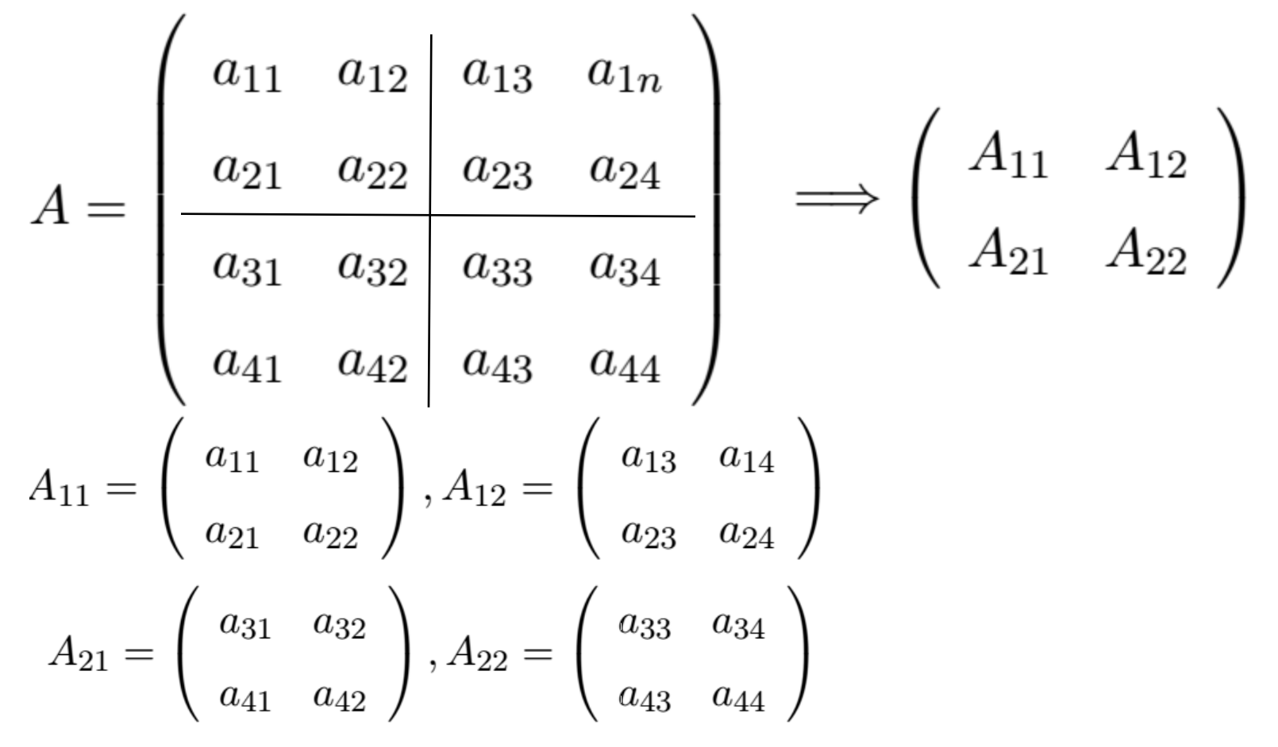
Option 1: Optimization using locality

Slide 56
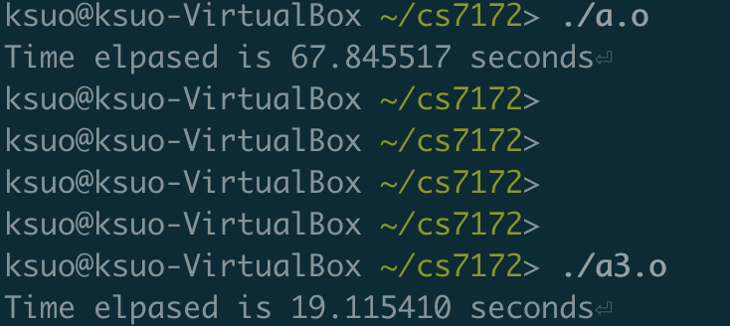
Option 1: Optimization using locality

Slide 57
Option 2: Optimization using parallel

Slide 58
Option 2: Optimization using parallel
Thread 1:
Thread 2:

Slide 59

Option 2: Optimization using parallel
https://www.cse.unr.edu/~fredh/class/415/Nolan/matrix_multiplication/writeup.pdf

Slide 60



Matrix-vector multiplication

Slide 61


Matrix-vector multiplication
Run-times and efficiencies of matrix-vector multiplication (times are in seconds)

Slide 62
Conclusion
Scope of variable
Reduce
Data and loop dependency
Schedule
Examples of OpenMP

Slide 63
Overview
Distributed coordination
Distributed scheduling
Distributed management
Distributed Computation
Distributed Storage
Distributed Communication
Distributed Resources

